Slide 1
Software Engineering (303105254)

Slide 2



Unit-6
Software Testing and Quality assurance
of IOT

Slide 3

Contents- Software Testing
Software Testing Concepts
Psychology of testing
Levels of testing
Testing Process-
test plan, test case design, Execution
Black-Box testing
Boundary value analysis
Pair wise testing
state based testing,
White-Box testing
criteria and test case generation and tool support
Image source : Google

Slide 4

Contents- Quality Assurance
Quality Control
Assurance, Cost, Reviews
Software Quality Assurance
Approaches to SQA
Reliability
Quality Standards- ISO9000 And 9001

Slide 5
Concepts
Testing is the process of exercising a program with the specific intent of finding errors prior to delivery to the end user.
To understand testing techniques that are geared to discover program faults
To introduce guidelines for interface testing
To understand specific approaches to object- oriented testing
●
●
●
To understand the principles of CASE tool support for testing

Slide 6
Psychology of testing
All tests should be traceable to customer requirements.
Tests should be planned long before testing begins.
The Pareto principle applies to software testing.
Testing should begin “in the small” and progress toward testing “in the large.”
Exhaustive testing is not possible.
To be most effective, testing should be conducted by an independent third party.

Slide 7

Software testing phases
Component testing
Individual program components testing
Tests are derived from the developer’s experience
Component Testing
Integration Testing
Software developer
Independent testing team
Figure 6.1 Software testing phase
Integration testing
Testing of groups of components integrated to create a system or sub-system
Tests are based on a system specification

Slide 8
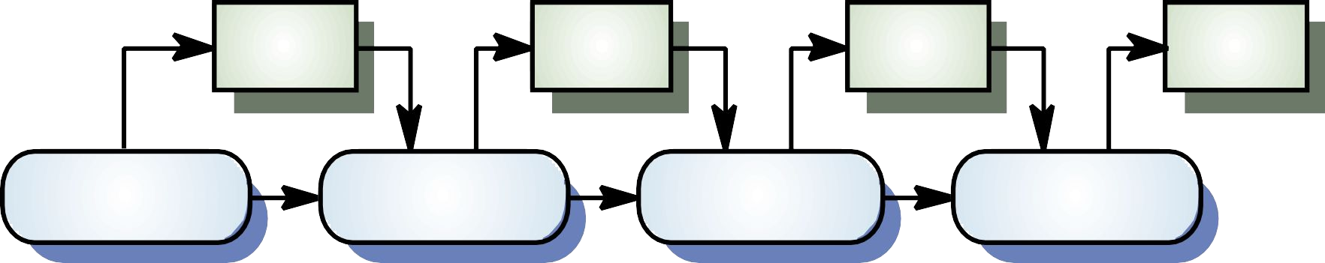
Testing process
Test cases
Test data
Test resul ts
Test report s
Design test cases
Prepare test data
Run program with test data
Compare results to test cases
Figure 6.2 Software testing process

Slide 9
Test plan
Test planning, the most important activity to ensure that there is initially a list of tasks and milestones in a baseline plan to track the progress of the project.
It also defines the size of the test effort.
It is the main document often called as master test plan or a project test plan and usually developed during the early phase of the project.

Slide 10
Test Planning Activities
To determine the scope and the risks that need to be tested and that are NOT to be tested.
Documenting Test Strategy.
Deciding Entry and Exit criteria.
Evaluating the test estimate.
Planning when and how to test and deciding how the test results will be evaluated, and defining test exit criterion.
Ensuring that the test documentation generates repeatable test assets.

Slide 11
Test case design
Test case design methods provide a mechanism that can help to ensure the completeness of tests
Provide the highest likelihood for uncovering errors in software.
Any product or system can be tested on two ways:
Knowing the specified function that a product has been designed to perform; (Black Box)
knowing the internal workings of a product, tests can be conducted to ensure that "all gears mesh," that is, internal operations are performed according to specifications (White box testing)

Slide 12
Test Execution
Test execution is the process of executing the code and comparing the expected and actual results.
Following factors are to be considered for a test execution process:
Based on a risk, select a subset of test suite to be executed for this cycle.
Assign the test cases in each test suite to testers for execution.
Execute tests, report bugs, and capture test status continuously.
Resolve blocking issues as they arise.
Report status, adjust assignments, and reconsider plans and priorities daily.
Report test cycle findings and status.

Slide 13
Levels of testing
There are different levels during the process of testing.
Levels of testing include different methodologies that can be used while conducting software testing.
The main levels of software testing are −
Functional Testing
Non-functional Testing

Slide 14
Functional Testing
This is a type of black-box testing that is based on the specifications of the software that is to be tested.
Functional testing of a software is conducted on a complete, integrated system to evaluate the system's compliance with its specified requirements.
There are five steps that are involved while testing an application for functionality.
The determination of the functionality that the intended application is meant to perform.
The creation of test data based on the specifications of the application.
The output based on the test data and the specifications of the application.
The writing of test scenarios and the execution of test cases.
The comparison of actual and expected results based on the executed test cases.

Slide 15
Unit Testing
This type of testing is performed by developers before the setup is handed over to the testing team to formally execute the test cases.
Unit testing is performed by the respective developers on the individual units of source code assigned areas.
The developers use test data that is different from the test data of the quality assurance team.
The goal of unit testing is to isolate each part of the program and show that individual parts are correct in terms of requirements and functionality.

Slide 16
Integration Testing
Integration testing is defined as the testing of combined parts of an application to determine if they function correctly.
Integration testing can be done in two ways: Bottom-up integration testing and Top-down integration testing.
Bottom-up integration
This testing begins with unit testing, followed by tests of progressively higher-level combinations of units called modules or builds.
Top-down integration
In this testing, the highest-level modules are tested first and progressively, lower-level modules are tested thereafter.

Slide 17
System Testing
System testing tests the system as a whole.
This type of testing is performed by a specialized testing team.
System testing is important because of the following reasons −
System testing is the first step in the Software Development Life Cycle, where the application is tested as a whole.
The application is tested thoroughly to verify that it meets the functional and technical specifications.
The application is tested in an environment that is very close to the production environment where the application will be deployed.
System testing enables us to test, verify, and validate both the business requirements as well as the application architecture.

Slide 18
Non-Functional Testing
Non-functional testing involves testing a software from the requirements which are nonfunctional in nature but important such as performance, security, user interface, etc.
Some of the important and commonly used non-functional testing types are discussed below.
Performance Testing
Load Testing
Stress Testing
Usability Testing
Security Testing
Portability Testing

Slide 19
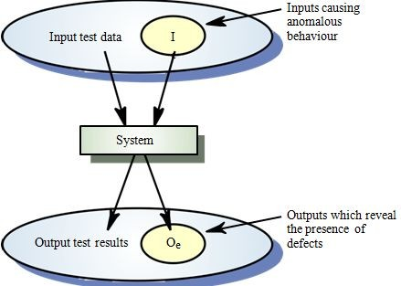
Black-Box testing
An approach to testing where the program is considered as a ‘black-box’
The program test cases are based on the system specification
Test planning can begin early in the software process
●
●
Figure 6.3 Black box testing

Slide 20
Continue…
Also called behavioral testing, focuses on the functional requirements of the software.
It enables the software engineer to derive sets of input conditions that will fully exercise all functional requirements for a program.
Black-box testing is not an alternative to white-box techniques but it is complementary approach.
Black-box testing attempts to find errors in the following categories:
Incorrect or missing functions,
Interface errors,
Errors in data structures or external data base access.
Behavior or performance errors,
Initialization and termination errors.

Slide 21
Continue…
Black-box testing purposely ignored control structure, attention is focused on the information domain.
Tests are designed to answer the following questions:
How is functional validity tested?
How is system behavior and performance tested?
What classes of input will make good test cases?
By applying black-box techniques, we derive a set of test cases that
Test cases that reduce the number of additional test cases that must be designed to achieve reasonable testing (i.e minimize effort and time)
satisfy the following criteria
Test cases that tell us something about the presence or absence of classes of errors

Slide 22
Boundary value analysis
Boundary value analysis is a test case design technique that complements equivalence partitioning.
Rather than selecting any element of an equivalence class, BVA leads to the selection of test cases at the "edges" of the class.
In other word, Rather than focusing solely on input
conditions, BVA derives test cases from the output domain as well.

Slide 23
Guidelines for BVA
If an input condition specifies a range bounded by values a and b, test cases should be designed with values a and b and just above and just below a and b.
If an input condition specifies a number of values, test cases should be developed that exercise the minimum and maximum numbers. Values just above and below minimum and maximum are also tested.
Apply guidelines 1 and 2 to output conditions.
If internal program data structures have prescribed boundaries be certain to design a test case to exercise the data structure at its boundary

Slide 24
Pair wise testing
Pairwise Testing is a type of software testing in which permutation and combination method is used to test the software.
used to test all the possible discrete combinations of the parameters involved.
It is a P&C based method, in which to test a system or an application, for each pair of input parameters of a system, all possible discrete combinations of the parameters are tested.
By using the conventional or exhaustive testing approach it may be hard to test the system
but by using the permutation and combination method it can be easily done.

Slide 25
Advantages of Pairwise Testing
The advantages of pairwise testing are:
Pairwise testing reduces the number of execution of test cases.
Pairwise testing increases the test coverage almost up to hundred percentage.
Pairwise testing increases the defect detection ratio.
Pairwise testing takes less time to complete the execution of the test suite.
Pairwise testing reduces the overall testing budget for a project.

Slide 26
Disadvantages of Pairwise Testing
The disadvantages of pairwise testing are:
Pairwise testing is not beneficial if the values of the variables are inappropriate.
In pairwise testing it is possible to miss the highly probable combination while selecting the test data.
In pairwise testing, defect yield ratio may be reduced if a combination is missed.
Pairwise testing is not useful if combinations of variables are not understood correctly.

Slide 27
State based testing
To understand the objects that are modeled in software and the relationships that connect these objects.
Next step is to define a series of tests that verify “all objects have the expected relationship to one another.
Stated in other way:
Create a graph of important objects and their relationships
Develop a series of tests that will cover the graph,
So that each object and relationship is exercised and errors are uncovered.
Begin by creating graph –
a collection of nodes that represent objects
links that represent the relationships between objects
node weights that describe the properties of a node
link weights that describe some characteristic of a link.

Slide 28
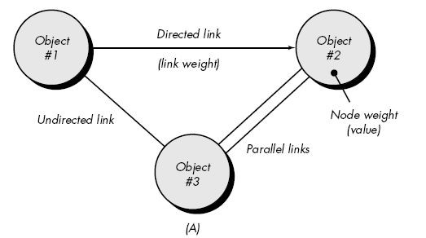
Continue…
Figure 6.4 Graph notation

Slide 29
Continue…
Nodes are represented as circles connected by links that take a number of different forms.
A directed link (represented by an arrow) indicates that a relationship moves in only one direction.
A bidirectional link, also called a symmetric link, implies
that the relationship applies in both directions.
Parallel links are used when a number of different relationships are established between graph nodes.

Slide 30
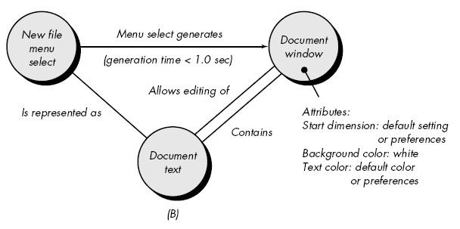
Continue…
Figure 6.5 Simple example

Slide 31
Continue…
Object #1 = new file menu select
Object #2 = document window
Object #3 = document text
Referring to example figure, a menu select on new file generates a document window.
The link weight indicates that the window must be generated in less than 1.0
second.
The node weight of document window provides a list of the window attributes that are to be expected when the window is generated.
An undirected link establishes a symmetric relationship between the new file
menu select and document text,
parallel links indicate relationships between document window and
document text

Slide 32
Continue…
Number of behavioral testing methods that can make use of graphs:
Transaction flow modeling.
The nodes represent steps in some transaction and the links represent the logical connection between steps
Finite state modeling.
The nodes represent different user observable states of the software and the links represent the transitions that occur to move from state to state. (Starting point and ending point)
Data flow modeling.
The nodes are data objects and the links are the transformations that occur to translate one data object into another.
Timing modeling.
The nodes are program objects and the links are the sequential connections between those objects.

Slide 33
White-Box testing
Test data
Test
Derives
s
Component code
Test outputs
Figure 6.6 Architecture of White –Box testing

Slide 34
Continue…
White-box testing is a test case design method
Uses the control structure of the procedural design to derive test cases
Using white-box testing methods, the software engineer can derive test cases that
Guarantee that all independent paths within a module have been exercised at least once
Exercise all logical decisions on their true and false sides
Execute all loops at their boundaries and within their operational bounds
Exercise internal data structures to ensure their validity.

Slide 35
Basis path testing
Basis path testing is a white-box testing technique
To derive a logical complexity measure of a procedural design.
Test cases derived to exercise the basis set are guaranteed to execute every statement in the program at least one time.
Methods:
Flow graph notation
Independent program paths or Cyclamatic complexity
Deriving test cases
Graph Matrices

Slide 36
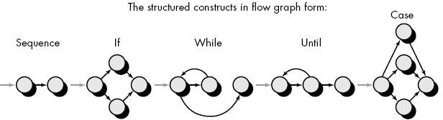
Flow Graph Notation
Start with simple notation for the representation of control flow (called flow graph). It represent logical control flow.
Figure 6.7 Flow graph notation

Slide 37
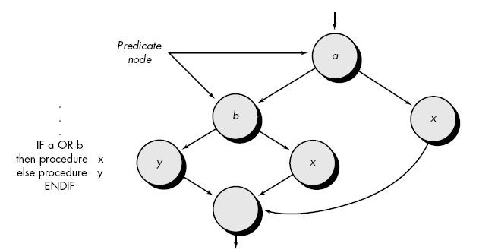
Continue…
A sequence of process boxes and decision diamond can map into a single node.
The arrows on the flow graph, called edges or links, represent flow of control and are parallel to flowchart arrows.
An edge must terminate at a node, even if the node does not
represent any
procedural
statement.
Areas bounded
by edges and
nodes are called regions.
When compound condition are encountered in procedural design,
flow graph becomes slightly more complicated.
Figure 6.8 Compound logic

Slide 38
Continue…
When we translating PDL segment into flow graph, separate node is created for each condition.
Each node that contains a condition is called predicate node and is characterized by two or more edges comes from it.

Slide 39
Independent program paths or Cyclomatic complexity
An independent path is any path through the program that introduces at least one new set of processing statement or new condition.
For example, a set of independent paths for flow graph: Path 1: 1-11
Path 2: 1-2-3-4-5-10-1-11
Path 3: 1-2-3-6-8-9-1-11
Path 4: 1-2-3-6-7-9-1-11
Note that each new path introduces a new edge.
The path 1-2-3-4-5-10-1-2-3-6-8-9-1-11 is not considered to an independent path because it is simply a combination of already specified paths and does not traverse any new edges.
Test cases should be designed to force execution of these paths (basis set).

Slide 40
Continue…
Cyclomatic complexity is a software metrics that provides a quantitative measure of the logical complexity of a program.
It defines no. of independent paths in the basis set and also provides number
of test that must be conducted.
One of three ways to compute cyclomatic complexity:
The no. of regions corresponds to the cyclomatic complexity.
Cyclomatic complexity, V(G), for a flow graph, G, is defined as V(G) = E - N + 2
where E is the number of flow graph edges, N is the number of flow
graph nodes.
Cyclomatic complexity, V(G), for a flow graph, G, is also defined as V(G) = P + 1
where P is the number of predicate nodes edges
So the value of V(G) provides us with upper bound of test cases.

Slide 41
Deriving Test Cases
It is a series of steps method.
The procedure average depicted in PDL.
Average, an extremely simple algorithm, contains compound conditions and loops.
To derive basis set, follow the steps.
Using the design or code as a foundation, draw a corresponding flow graph.
A flow graph is created by numbering those PDL statements
that will be mapped into corresponding flow graph nodes.

Slide 42
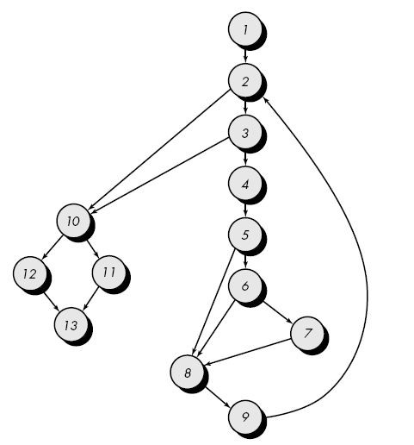
Deriving Test Cases
Flow graph for the procedure average

Slide 43
Continue…
2.
Determine the cyclomatic complexity of the resultant flow graph.
V(G) can be determined without developing a flow graph by counting all conditional statements in the PDL (for the procedure average, compound conditions count as two) and adding 1
V(G) = 6 regions
V(G) = 17 edges - 13 nodes + 2 = 6
V(G) = 5 predicate nodes + 1 = 6
3.
Determine a basis set of linearly independent paths
The value of V(G) provides the number of linearly independent paths through the program control structure.
path 1: 1-2-10-11-13
path 2: 1-2-10-12-13
path 3: 1-2-3-10-11-13
path 4: 1-2-3-4-5-8-9-2-. . .
path 5: 1-2-3-4-5-6-8-9-2-. . .
path 6: 1-2-3-4-5-6-7-8-9-2-. . .
The ellipsis (. . .) following paths 4, 5, and 6 indicates that any path through the remainder of the control structure is acceptable.

Slide 44
Continue…
Prepare test cases that will force execution of each path in the basis set.
Data should be chosen so that conditions at the predicate
nodes are appropriately set as each path is tested.
Each test case is executed and compared to expected results.
Once all test cases have been completed, the tester can be
sure that all statements in the program have been executed at least once.

Slide 45
Graph Matrices
A graph matrix is a square matrix whose size (i.e., number of rows and columns) is equal to the number of nodes on the flow graph.
Each row and column corresponds to an identified node, and matrix entries correspond to connections (an edge) between nodes.
Each node on the flow graph is identify by numbers, while each edge is identify by letters.
The graph matrix is nothing more than a tabular representation of a flow graph.
By adding a link weight to each matrix entry, the graph matrix can become a powerful tool for evaluating program control structure during testing.
The link weight provides additional information about control flow. In its simplest form, the link weight is 1 (a connection exists) or 0 (a connection does not exist).

Slide 46
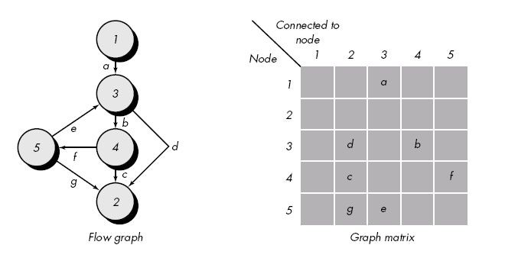
Continue…

Slide 47
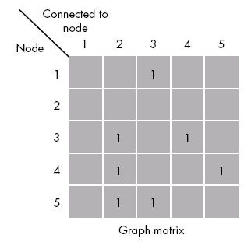
Connection matrix
Figure 6.9 Connection matrix

Slide 48
Connection matrix
Each letter has been replaced with a 1, indicating that a connection exists (this graph matrix is called a connection matrix).
In fig.( connection matrix) each row with two or more entries represents a predicate node.
We can directly measure cyclomatic complexity value by performing arithmetic operations
Connections = Each row Total no. of entries – 1.
V(G)= Sum of all connections + 1

Slide 49
Quality Control - Quality
Quality as “a characteristic or attribute of something.”
Two kinds of quality may be encountered:
Quality of design of a product increases, if the product is manufactured according to specifications.
Quality of conformance is the degree to which the design specifications are followed during manufacturing.
In software development
Quality of design encompasses requirements, specifications, and the design of the system.
Quality of conformance is an issue focused primarily on implementation.
User satisfaction = compliant product + good quality + delivery within budget and schedule

Slide 50
Quality control process
Quality control involves the series of inspections, reviews, and tests used throughout the software process.
Quality control includes a feedback loop to the process.
A key concept of quality control is that all work products have defined, measurable specifications to which we may compare the output of each process.
The feedback loop is essential to minimize the defects produced.

Slide 51
Quality Assurance
Quality assurance consists of the auditing and reporting functions of management.
If the data provided through quality assurance identify problem
it is management’s responsibility to address the problems and
apply the necessary resources to resolve quality issues.

Slide 52
Cost of Quality
The cost of quality includes all costs incurred in the pursuit of quality or in performing quality-related activities.
Quality costs may be divided 3 mode of cost:
Prevention
Appraisal
Failure.

Slide 53
Continue…
Prevention costs include:
Quality planning
Formal technical reviews
Test equipment
Training
Appraisal costs include activities to gain insight into product
In-process and Inter-process inspection
Equipment calibration and maintenance
Testing

Slide 54
Continue…
Failure costs
Internal Failure Cost
o rework
o repair
o failure mode analysis
External Failure Cost
complaint resolution
product return and replacement
help line support
warranty work

Slide 55

Software Quality Assurance
Definition:
Conformance to explicitly stated functional and performance requirements, explicitly documented development standards, and implicit characteristics
that are expected of all professionally developed software.
Definition serves to emphasize three important points:
Software requirements are the foundation from which quality is measured.
If specified standards criteria are not followed, lack of quality will almost surely result.
A set of implicit requirements often goes unmentioned.

Slide 56
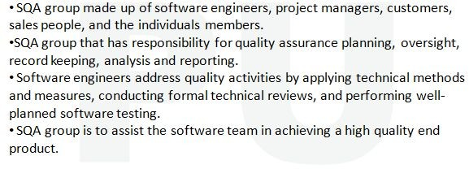
SQA group Activity

Slide 57
Role of an SQA group
1. Prepares an SQA plan for a project.
The plan is developed during project planning and is reviewed by all stakeholders.
The plan identifies
Evaluations to be performed
Audits and reviews to be performed
Standards that are applicable to the project
Procedures for error reporting and tracking
Documents to be produced by the SQA group
Amount of feedback provided to the software project team

Slide 58
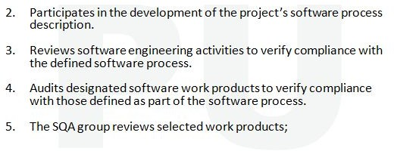
Continue…

Slide 59
Software Reliability
Software reliability is defined in statistical terms as "the probability of failure-free operation of a computer program in a specified environment for a specified time“.
What is meant by the term failure?
Failure is nonconformance to software requirements.
Correction of one failure may in fact result in the introduction of other errors that ultimately result in other failures.
Software reliability can be measured directed and estimated using
historical and developmental data.

Slide 60
Measures of Reliability and Availability
A simple measure of reliability is mean-time- between-failure (MTBF), where
MTBF = MTTF + MTTR
The acronyms MTTF and MTTR are mean-time-to-failure and mean-time-to-repair, respectively.
MTBF is a far more useful measure than defects/KLOC or defects/FP.
Stated simply, an end-user is concerned with failures, not with the total error count.
a reliability measure, we must develop a measure of availability

Slide 61
Continue…
Software availability : It is the probability that a program is operating according to requirements at a given point in time and is defined as
Availability = [MTTF/(MTTF + MTTR)] 100%
The MTBF reliability measure is equally sensitive to MTTF and MTTR.
The availability measure is somewhat more sensitive to MTTR, an
indirect measure of the maintainability of software

Slide 62
Quality Standards- ISO9000 And 9001
SQA Standards
Software quality assurance standards can be classified into two main classes −
Software quality assurance management standards, including certification and assessment methodologies (quality management standards)
Software project development process standards (project process standards)

Slide 63
Quality Management Standards
These focus on the organization’s SQA system, infrastructure and requirements,
while leaving the choice of methods and tools to the
organization.
With quality management standards, organizations can steadily assure that their software products achieve an acceptable level of quality.
Example − ISO 9000-3 and the Capability Maturity Model
(CMM)

Slide 64
ISO 9001 Certification
ISO (the International Organization for Standardization) is a worldwide federation of national standards bodies.
ISO technical committees prepare the International Standards.
ISO collaborates closely with the International Electro-technical Commission (IEC) on all matters of electro-technical standardization.
International Standards are drafted in accordance with the rules given in the ISO/IEC Directives, Part 2.
Draft of the International Standards adopted by the technical committees is circulated to the member bodies for voting.
ISO 9001 was prepared by Technical Committee ISO/TC 176, Quality management and quality assurance, Subcommittee SC 2, Quality systems.

Slide 65
References
Pressman, Roger S. Software engineering: a practitioner's approach. Palgrave Macmillan, 2005.
Sommerville, Ian. Software Engineering: Pearson New International Edition. Pearson Education Limited, 2013.
Jalote, Pankaj. An integrated approach to software engineering. Springer Science & Business Media, 2012.
www.google.com

Slide 66


www.paruluniversity.ac.in

